Slide 1
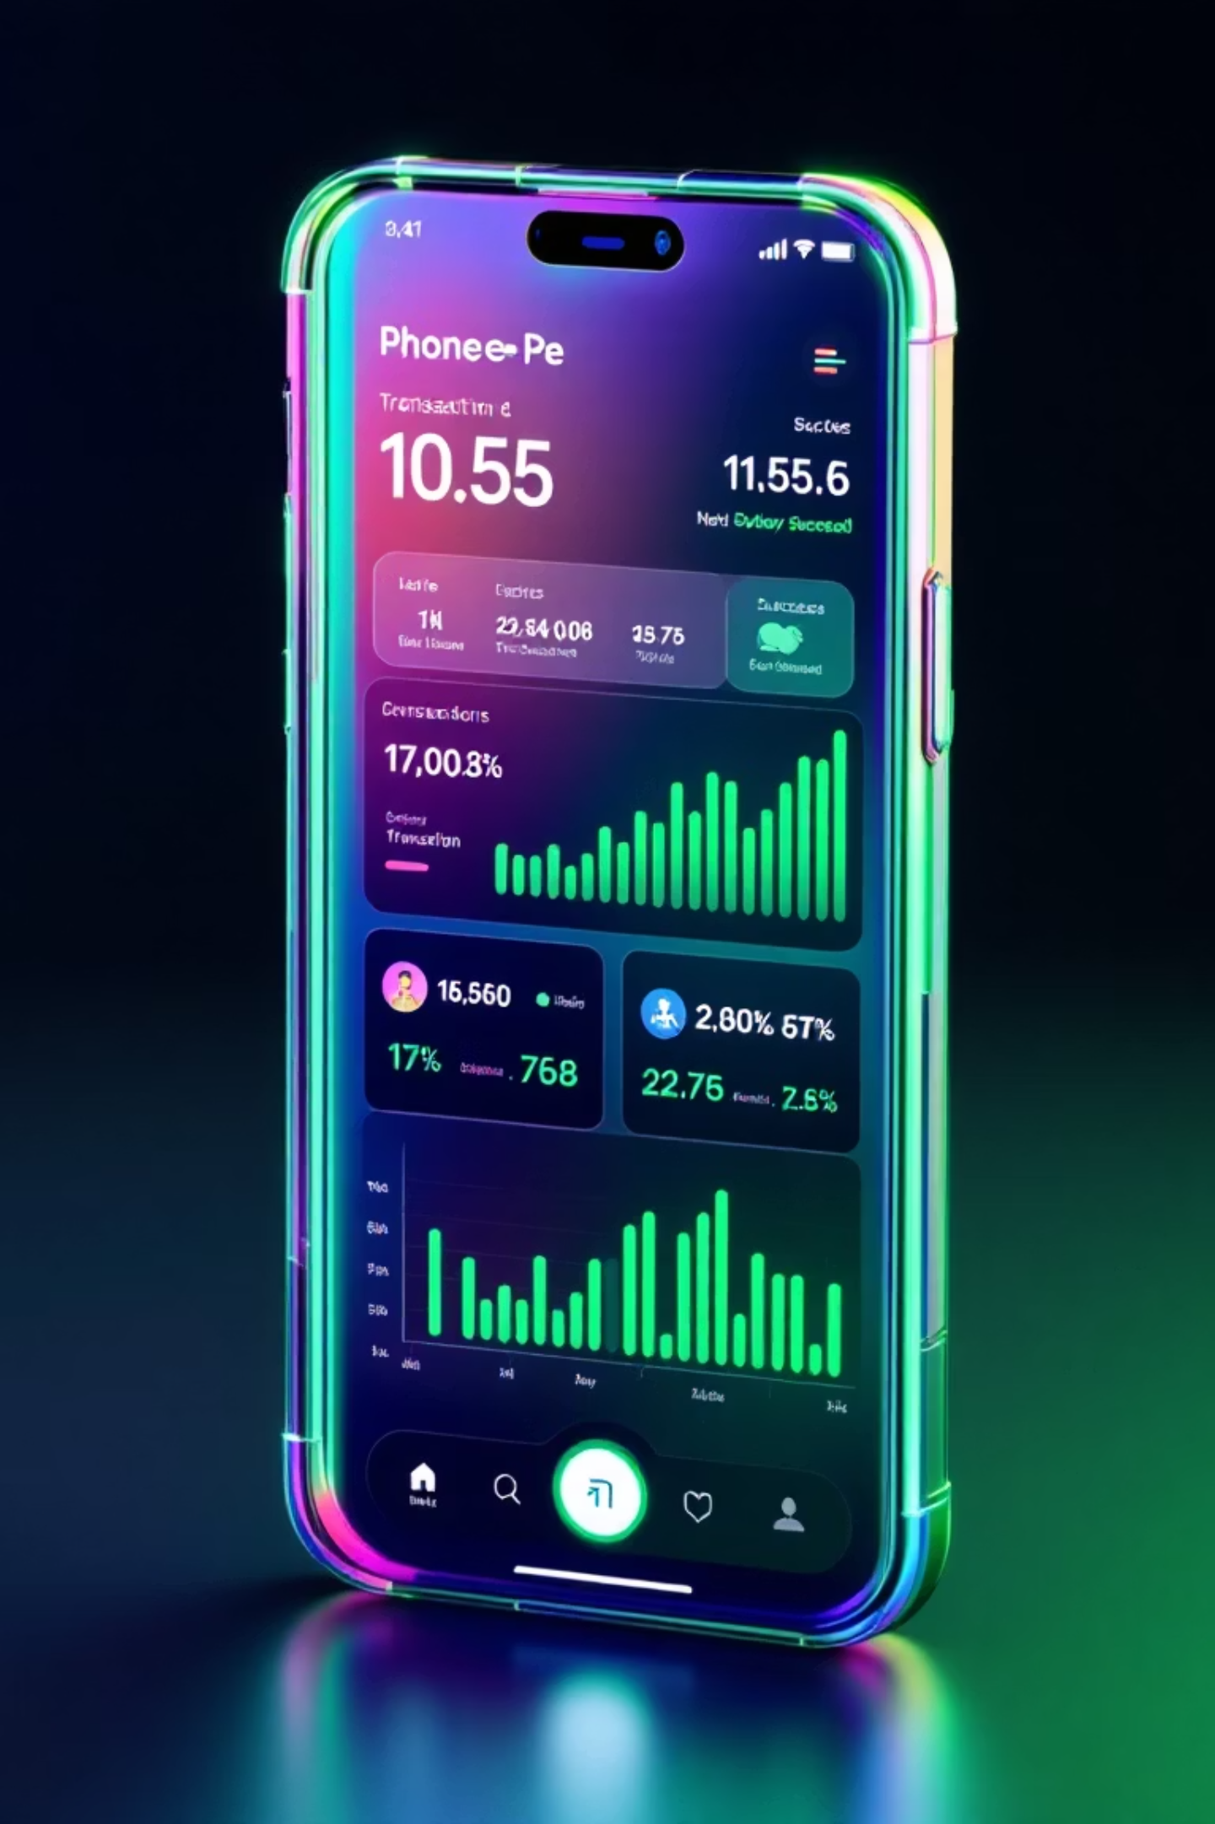
Driving Financial Inclusion
PhonePe 2024 Performance & Growth Roadmap
₹6.7B processed | 371K transactions | 96% success rate
01
Executive Summary
Core metrics and YoY growth momentum
02
Service Breakdown
Performance across five key verticals
03
Key Trends
Monthly patterns and success rates
04
Optimization Roadmap
Targeted fixes to reach 99% success

Slide 2
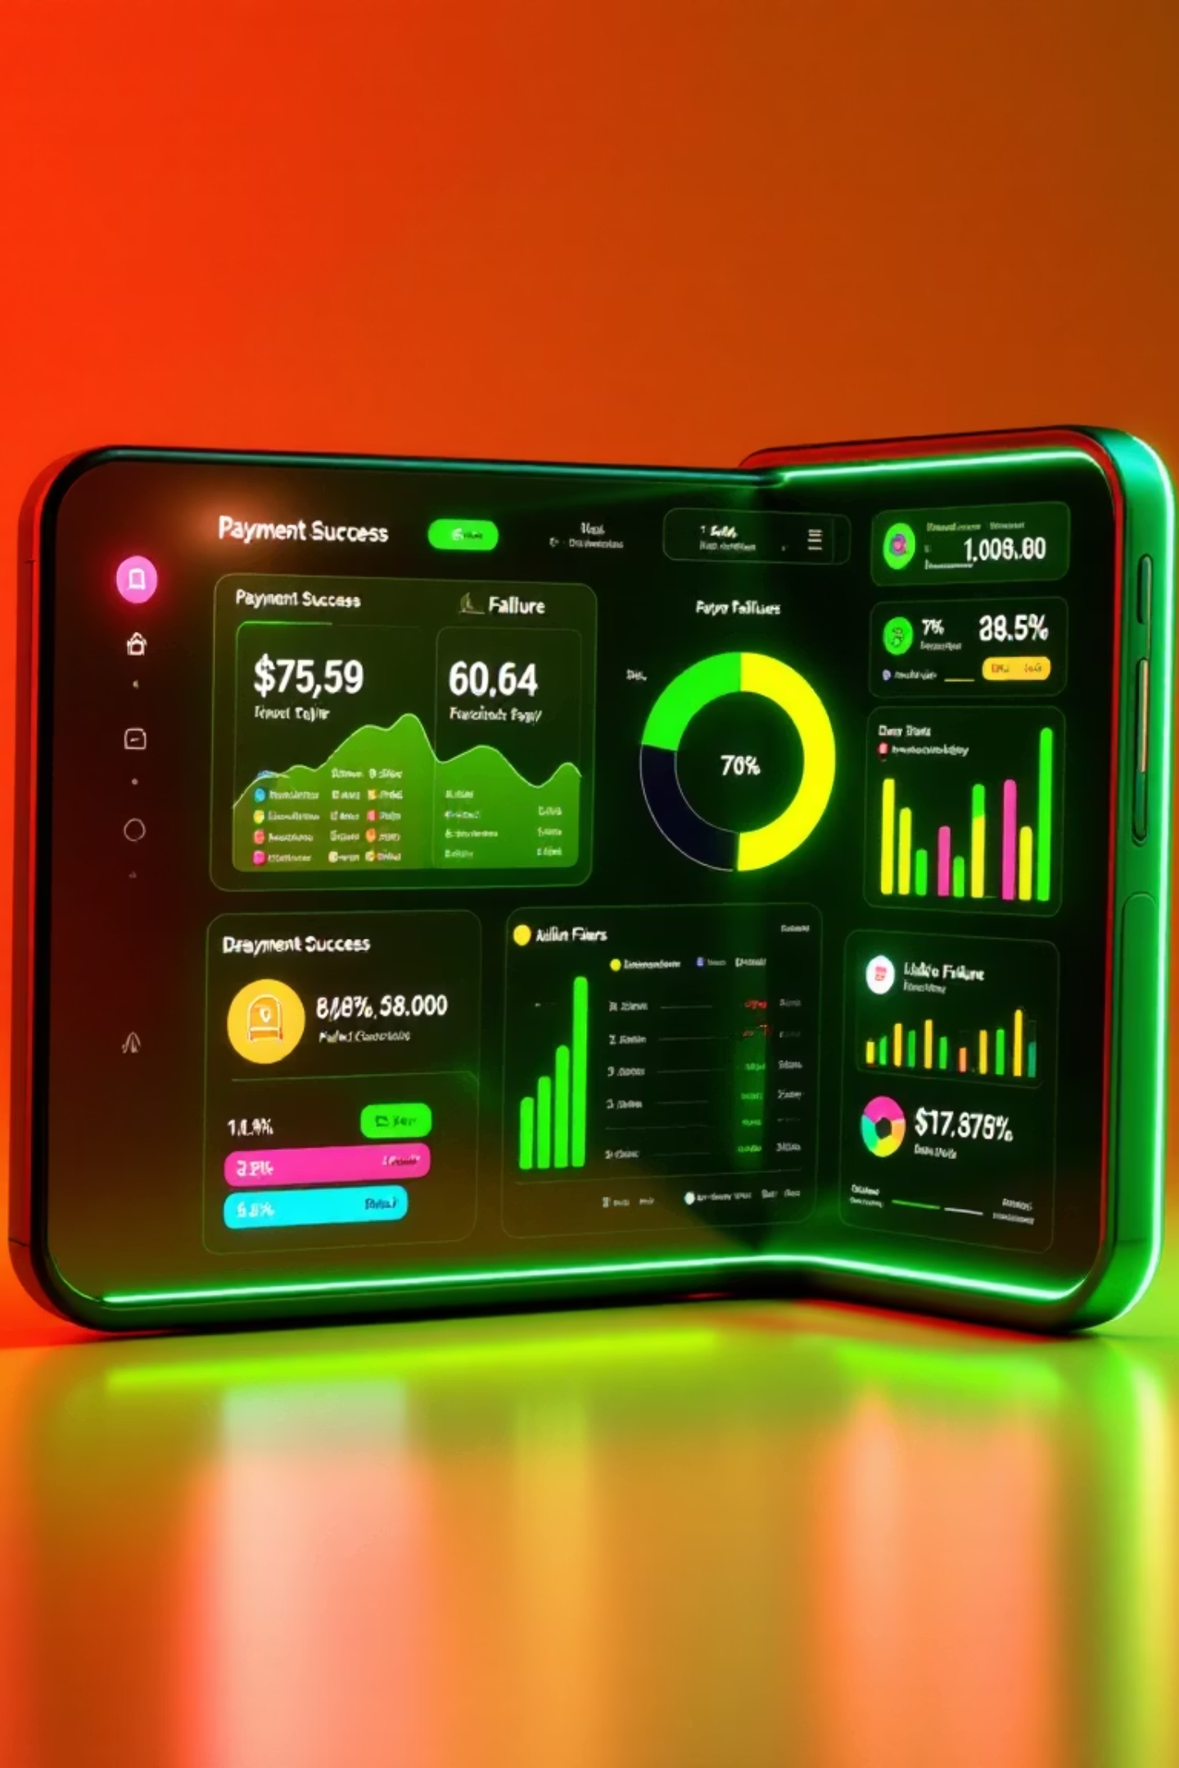
Executive Summary: Q1 2024 Performance
₹6.7B
371K
356K
Total Amount Processed
Total Transactions
Successful Transactions
+15% YoY growth
+12% YoY growth
96% success rate, +18% YoY
15K
Failed Transactions
4% failure rate, -5% YoY
Portfolio Composition
Success Leaders
Loans/Credit: ₹2.4B (36% of volume)
Recharges/Bills: 99%
General Services: ₹3.3B (50%)
General Services: 96%
Insurance: ₹513M (8%)
Money Transfer: 70%
Other: ₹429M (6%)
Insurance: 48%
Credit/Loans: 3%

Slide 3





Service Breakdown: Five Verticals Analyzed
Insurance
₹513M | 48% success
Car, Bike, Term Life, Health balanced across portfolio
Loans & Credit
₹2.4B | 3% success
Auto, Gold, Mutual Funds—urgent optimization needed
Money Transfer
₹378M | 70% success
UPI, Self, QR, Mobile methods evenly distributed
Recharges & Bills
₹51M | 99% success
Electricity, DTH, Mobile, Cable—reliability leader
Failure Root Causes:
High-Failure Services
Technical Issues (All)
Loans: Bank Declined (70%)
Server Errors: 35–67%
Transfers: Insufficient Funds (45%)
Wrong PIN/Auth: 32–77%
Insurance: Wrong PIN (77%)
Insufficient Funds: 45–60%

Slide 4
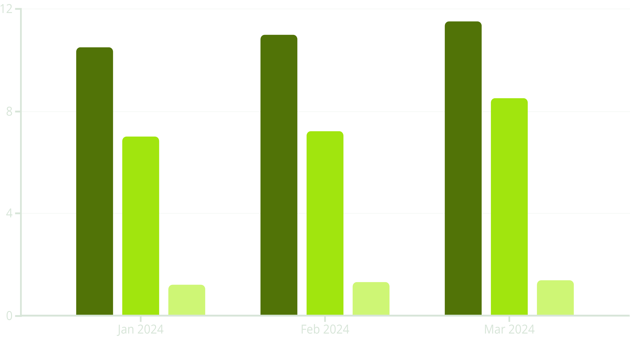

Q1 Trends & Growth Trajectory
Monthly processing shows consistent Q1 uplift with seasonal peaks mid-year. Success rates vary dramatically across services—positioning opportunity for 25% market share in UPI fintech.
General (₹M)
Loans (₹M)
Insurance (₹M)
Momentum: 10–15% MoM Growth
Success Rate Hierarchy
Q1 uplift signals habit-forming user behavior; project 25% Q4 spike with holiday season
Recharges 99% → General 96% → Transfers 70% → Insurance 48% → Credit 3%
Optimization Target: 99% Success
Full-Year Projection
Focus on credit (97% fails), insurance authentication (77% Wrong PIN), and transfer liquidity checks
₹28B by December 2024 with 20% market share gains in UPI fintech ecosystem

